Slide 1
Level 3
Student’s name:

Slide 2
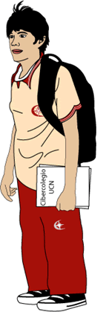
On next video you’ll find the way to report what other people say. See the examples and explanations and then report what people in your family or neighborhood say:
10 sentences which follow next example:
Mother – father: I’ll miss you when you travel on business
My mother says my father that she will miss him when he travels on business.
http://www.youtube.com/watch?v=iLUhWd9T6Vc
Parents – son:
“If you study hard, you’ll be an excellent professional”
My parents say that if I study hard, I’ll be an excellent professional

Slide 3

Write down a personal story, it can be an interesting anecdote, or something special that happened to you, these are possible titles or topics, the words in the second chart can be helpful. Send your pronunciation
First day in school | My best vacations | A terrible Accident
My first pet | My best party | Meeting a celebrity
A natural disaster | A good dream | A nightmare
When: cuando o cuándo. | Suddenly: “de repente” | Before: “antes”
At last: por último, al fin. | Then: “entonces” | After: “después”
Until: hasta. | Later: “más tarde” | Finally: “finalmente”

